Slide 1

AiNspire Employee Journey
Understand your potential. Find your contribution.
START: EMPLOYEE
Approved, then assigned
01
02
03
04
Understand
Develop
Deploy
Measure
Complete assessment
View AI persona
and confidence
View personalised
learning pathway
Complete learning
and record progress
View matching role
and AI projects
Show interest for
supervisor review
Complete assigned
project work
Review contribution
outcomes
CONTRIBUTION REALISED
SUPERVISOR DECISION
Approved: confirm capacity and assignment
Rejected: agree support or another project
Cost avoidance, cost saving, productivity
and internalisation gains
Powered by IT as a Service (ITaaS), GITD
Notes:
Employee journey summary based on the agreed AiNspire process. The employee begins with assessment. Persona, confidence and reflection guide personalised learning. The recommended contribution role connects to suitable AI projects. Showing interest creates a supervisor review request, not immediate acceptance or assignment. Approval and assignment are separate. Rejection should provide a reason and support or an alternative project. After assignment, the employee participates and completes work. The project owner and validator assess benefit evidence. Benefit categories can overlap and should not be double counted. Profile confidence means evidence consistency, not certified competence. Current supervisor routing and same-browser records are a POC simulation. Source: AiNspire current POC source and approved process in this conversation, 11 October 2026.

Slide 2
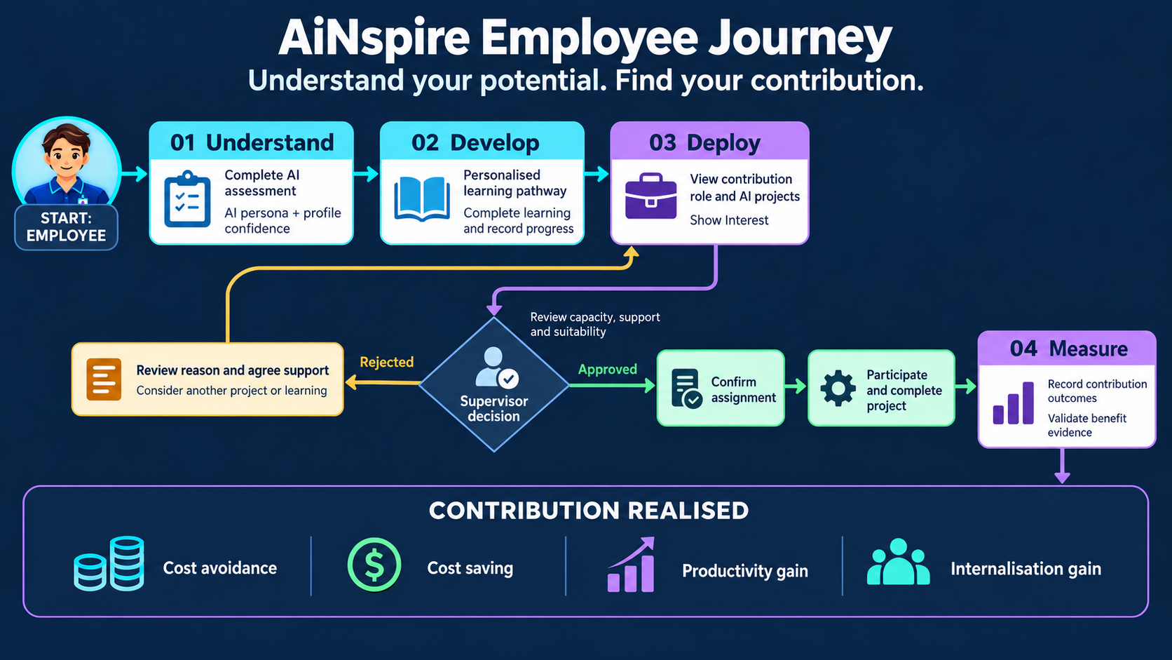

Slide 3
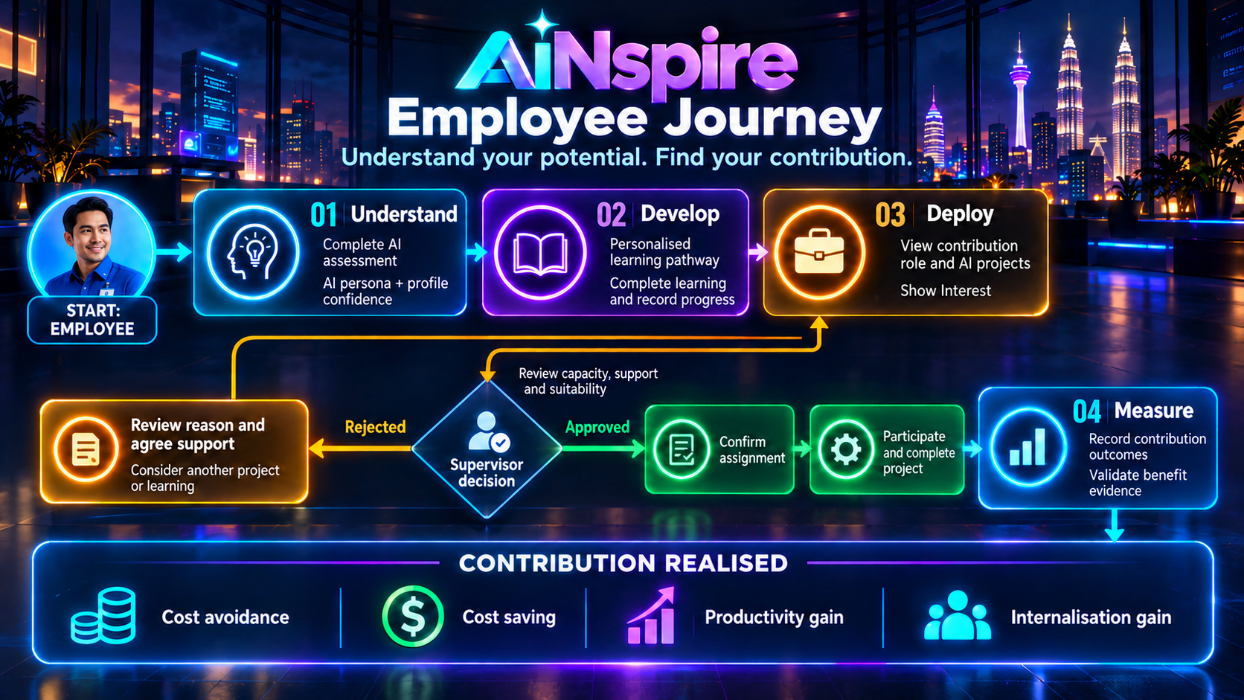

Slide 4
AiNspire HR Journey
Observe, analyse and act on workforce evidence.
START: AFTER EMPLOYEE ASSESSMENT
01
02
03
04
Understand
the Workforce
Develop
Capabilities
Develop
Talents
Review
Outcome
Track participation
and AI readiness
Review confidence
and clarification
Analyse skill gaps
and learning impact
Draft 90-day
upskilling plans
Track interest
and approvals
Review capacity
and assignments
Check contributions
and benefits
Prioritise next
workforce actions
STRATEGIC WORKFORCE DECISIONS
Upskill where gaps persist.
Deploy where capacity allows.
Recognise evidenced contribution.
Review validated benefits before scaling.
Powered by IT as a Service (ITaaS), GITD
Notes:
HR begins after employee assessment and monitors data continuously rather than waiting for every stage to finish. Understand: examine participation, guided AI readiness, persona distribution and profile evidence consistency. Review reflection-provided/review-pending and clarification-required/reflection-pending records. Develop: prioritise capability gaps by division and persona, recommend relevant courses, generate a draft 90-day upskilling plan for the selected persona and assess learning evidence. Develop Talents: monitor interest, supervisor approval/rejection reasons, confirmed capacity, separate assignment and utilisation. HR supports workforce planning and does not automatically assign staff from persona alone. Review Outcome: inspect completed contributions and project-level benefit evidence with owner/validator review. Cost avoidance, cost saving, productivity and internalisation can overlap and must not be double counted. These insights feed the next workforce decisions. Current dashboard figures are illustrative POC samples. Supervisor routing and same-browser records are simulated. Source: approved AiNspire HR process and scope in this conversation, 11 October 2026.

Slide 5
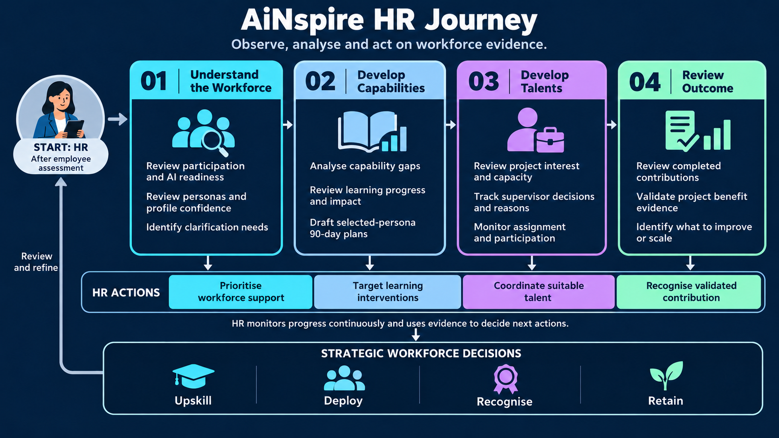

Slide 6
